Slide 1
ELEVATOR SIMULATION
Group members
Divya H C
Anusha
Nayana U S Guided by:
Chandana R S Shrinivasan Shetty

Slide 2
ELEVATOR:
An elevator or lift is a vertical transport vehicle that efficiently moves people or goods between floors of a building.
Components :
Arduino Mega 2560
Elevator model
Wires
9v Battery

Slide 3
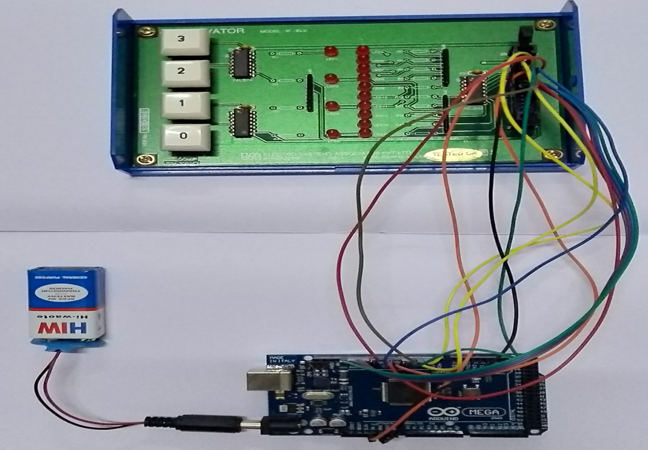
Elevator Simulation:

Slide 4
Elevator benefits:

Slide 6
THANK
YOU

